Slide 1
Basic Internship@Clevered DESK AI
App User Manual
Author: Bhavya Kumar

Slide 2
Acknowledgements
A small vote of thanks for all who have helped you in this journey of App Development –, Mr Ken, CleverEd Mentor ,and websites used (GeekForGeek, tutorialspoint etc).

Slide 3
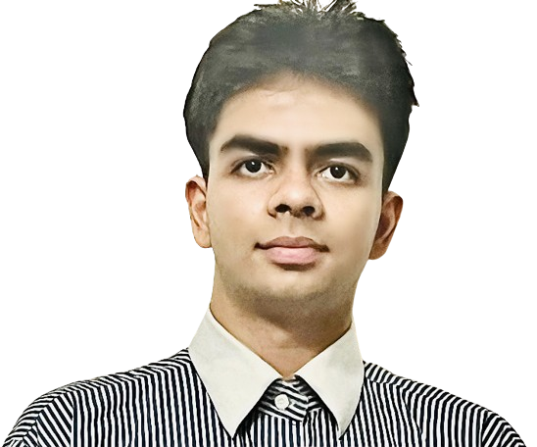
About Me..
Hi I am Bhavya , I like to do coding, problem solving , some calculus, 3D modelling and gaming.
I m currently in grade 12 pursuing Physics , Chemistry, Math and CS.

Slide 4
About My Internship with Clevered..
In this fantastic internship with Clevered I learnt many things in python
Like speech recognition , text to speech , web browser URL opener and OS related functions.
Mani ma’am helped me throughout the internship in dealing with bugs and problems I encountered.
This was a very enlightening experience for me which taught me things I didn’t know in python and also developed my overall coding skills.

Slide 5

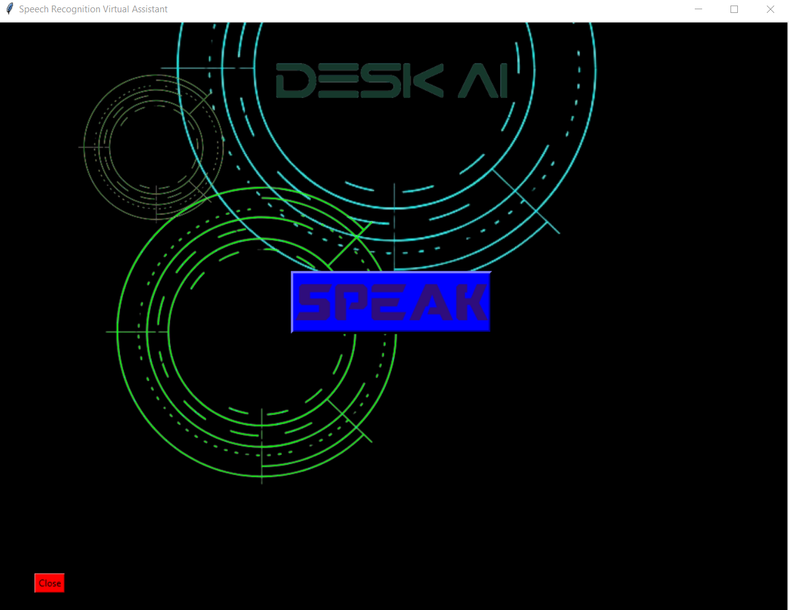
About App..
To keep the app simple and easy to use. Only single main button is kept ‘speak’. Which will perform nearly all functions without adding more buttons.
User is also given close button or they can say ‘thank you’ to close Desk AI

Slide 6
How do I use the App?

Slide 7

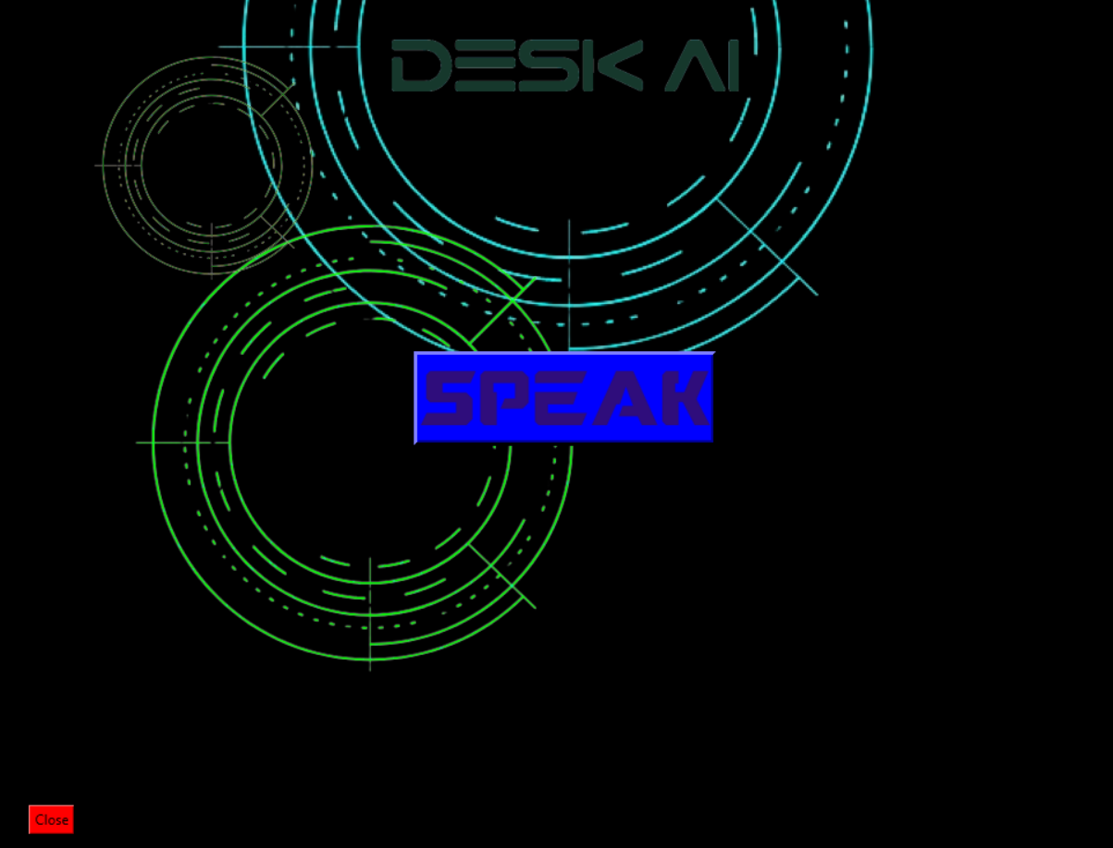
Main Screen
Must be installed using pip:
Tkinter
Speech Recognition
Text to Speech
Web browser
OS
All images must be present in same folder as code

Slide 8
Contact Person
Please reach out to Bhavya at bhavyakumar.bkb@gmail.com
for any question or bug report.

Slide 9
Thank you!

